Slide 1
Sepsis Prediction in ICU
Vyshak Sugunan

Slide 2
Agenda
Project Goal
Exploratory Analysis
Predictive Models
Model Selection
Findings and Conclusions
Next Step

Slide 3

Project Goal
To predict sepsis development during a patient’s ICU stay
Sepsis is a life-threatening condition that arises when the body's response to infection causes injury to its own tissues and organs
#1 cause of death in hospitals, worldwide
Chances of survival reduces considerably after going into sepsis. So early detection, monitoring and treatment is crucial
Notes:
Sepsis - why is it bad?

Slide 4

Exploratory Analysis

Slide 5
Data Overview
40,336 patients
41 features
Data
34 Vitals and medical info, 2 demos,
4 hospital info and Sepsis flag

Slide 6
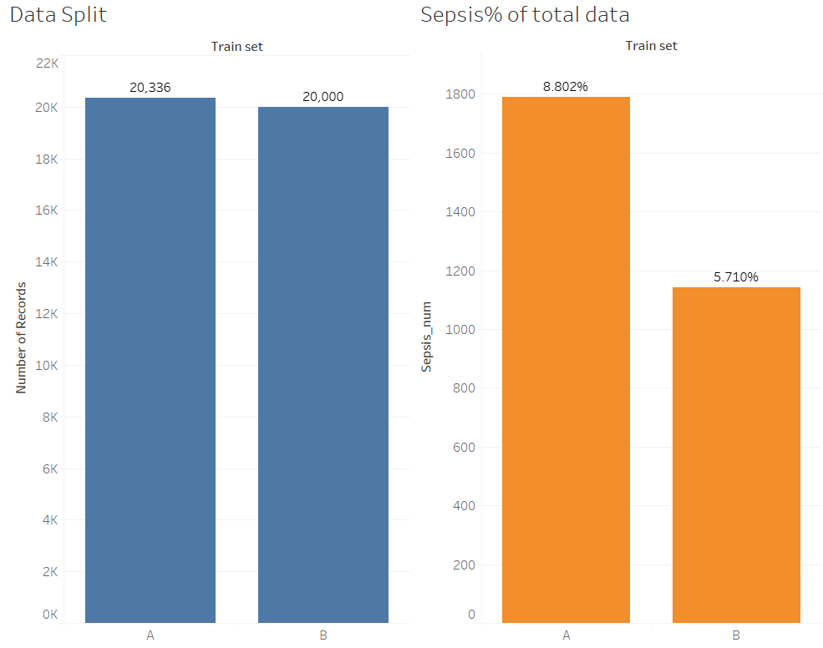
Limited occurrence of Sepsis in available data
Notes:
Why recall rate is important

Slide 7
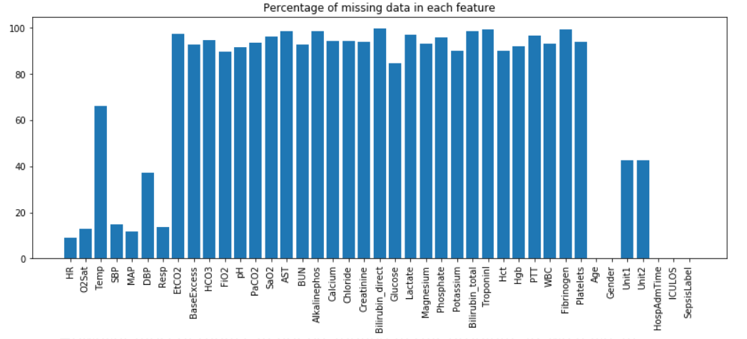
Large number of NA data
Notes:
Why we took limited features into our model

Slide 8
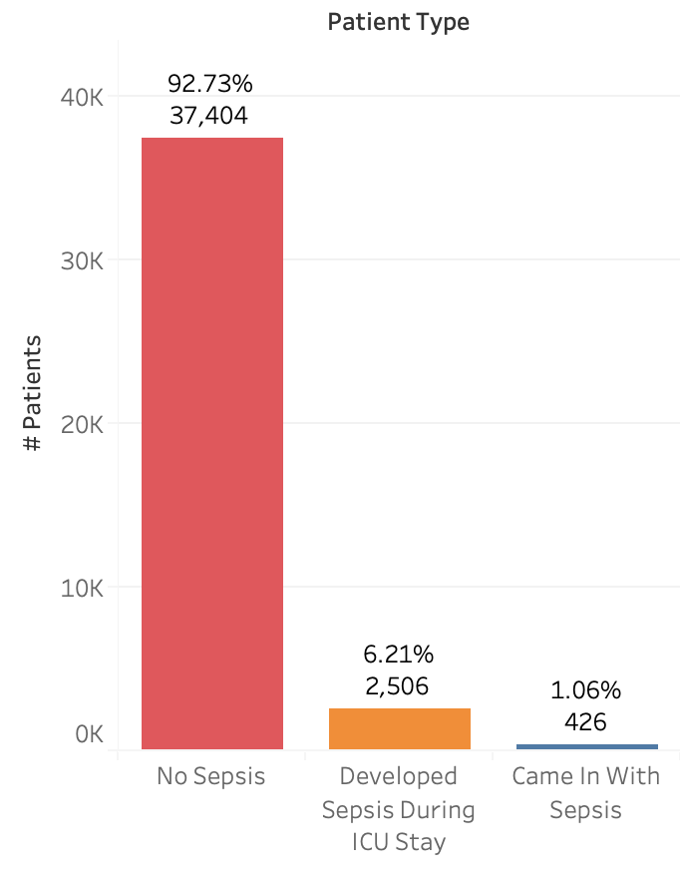
Three Distinct Types of Patients
Came into ICU with Sepsis
Developed Sepsis during ICU stay
Never had Sepsis

Slide 9
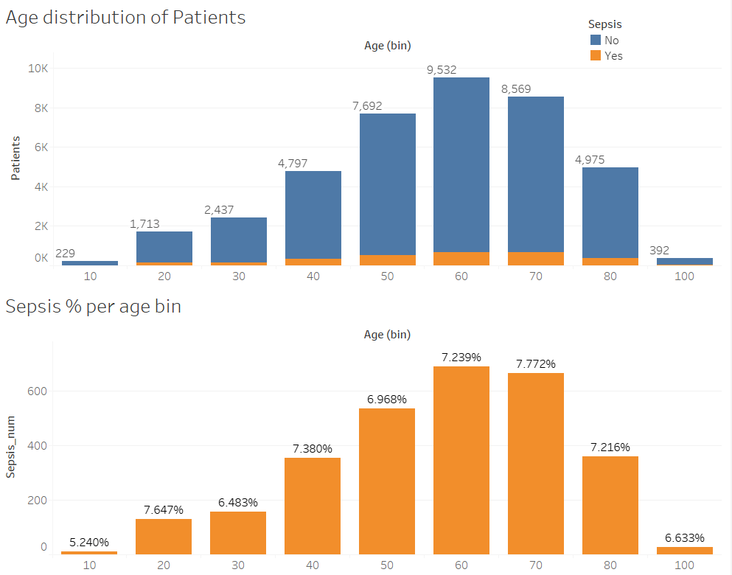
Older adults have more ICU Cases and Sepsis cases
Notes:
Health deteriorates with age

Slide 10
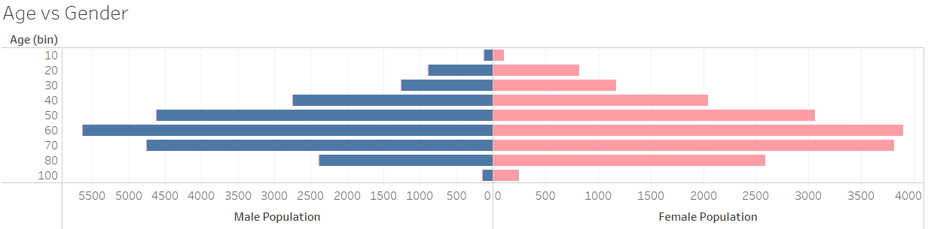
Similar Age distribution for Males and Females
Notes:
Females have a bit more records on the older end

Slide 11
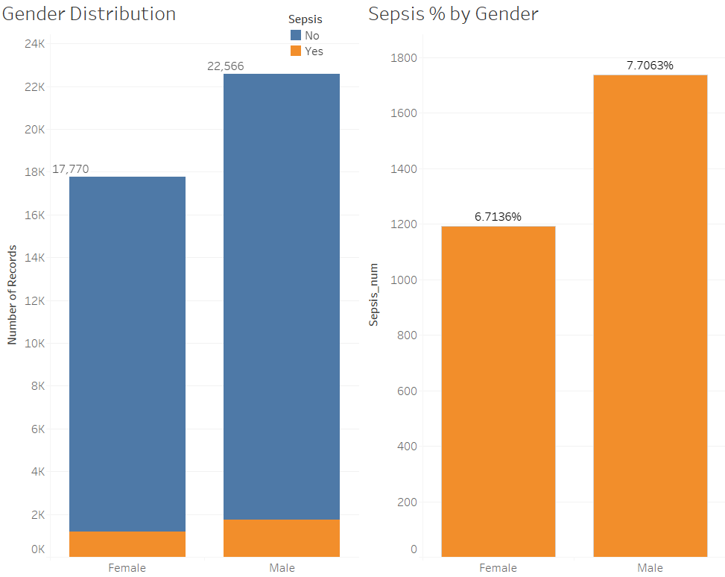
Males represent more ICU patients and higher Sepsis %
Notes:
More male records. Males have higher % of sepsis but nothing causal or conclusive to be drawn

Slide 12
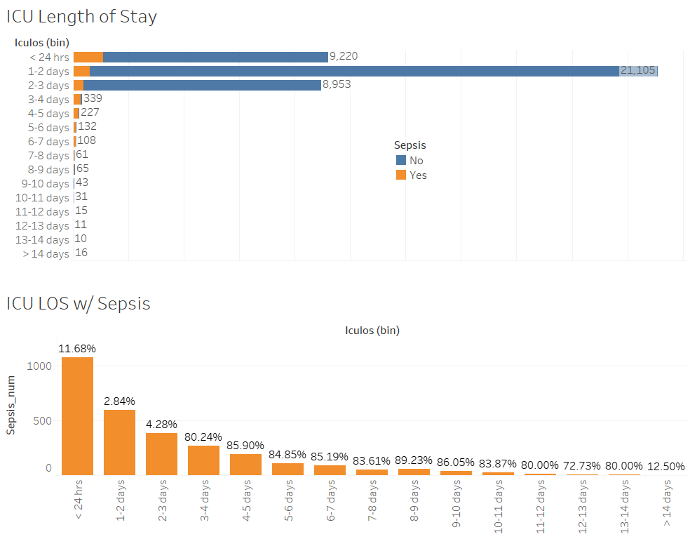
ICU Length of Stay distribution
Notes:
As ICU Los increases chances of Sepsis increases

Slide 13
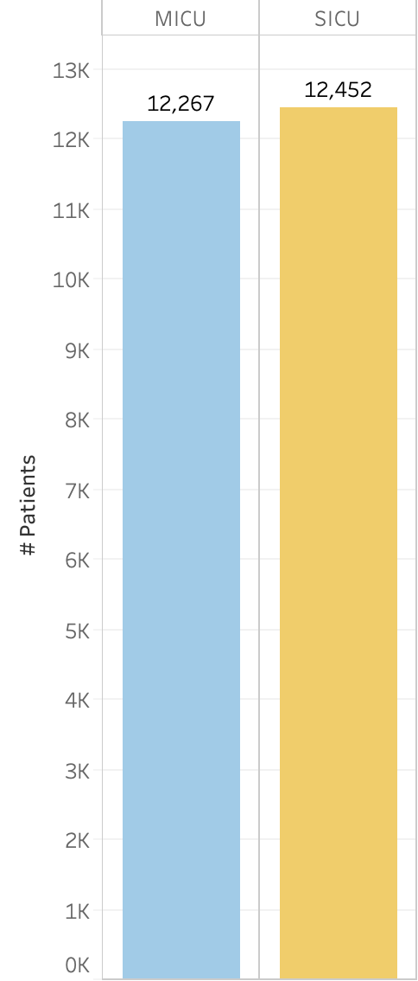
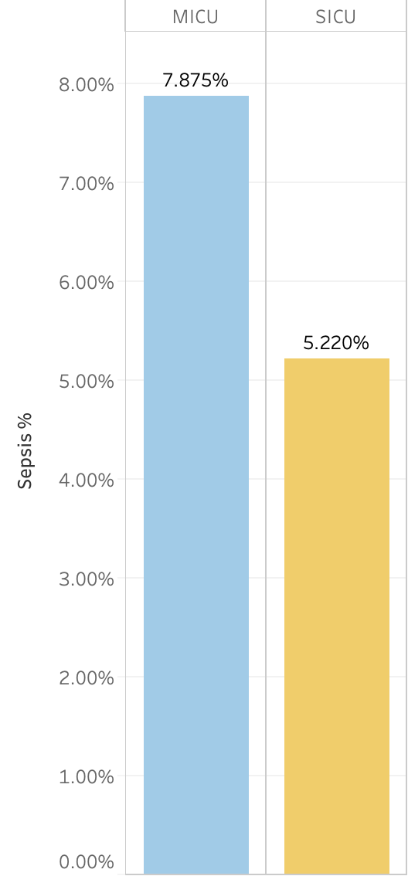
MICU vs SICU patient split is almost equal,
but MICU had higher Sepsis %
# Patients
% Sepsis

Slide 14
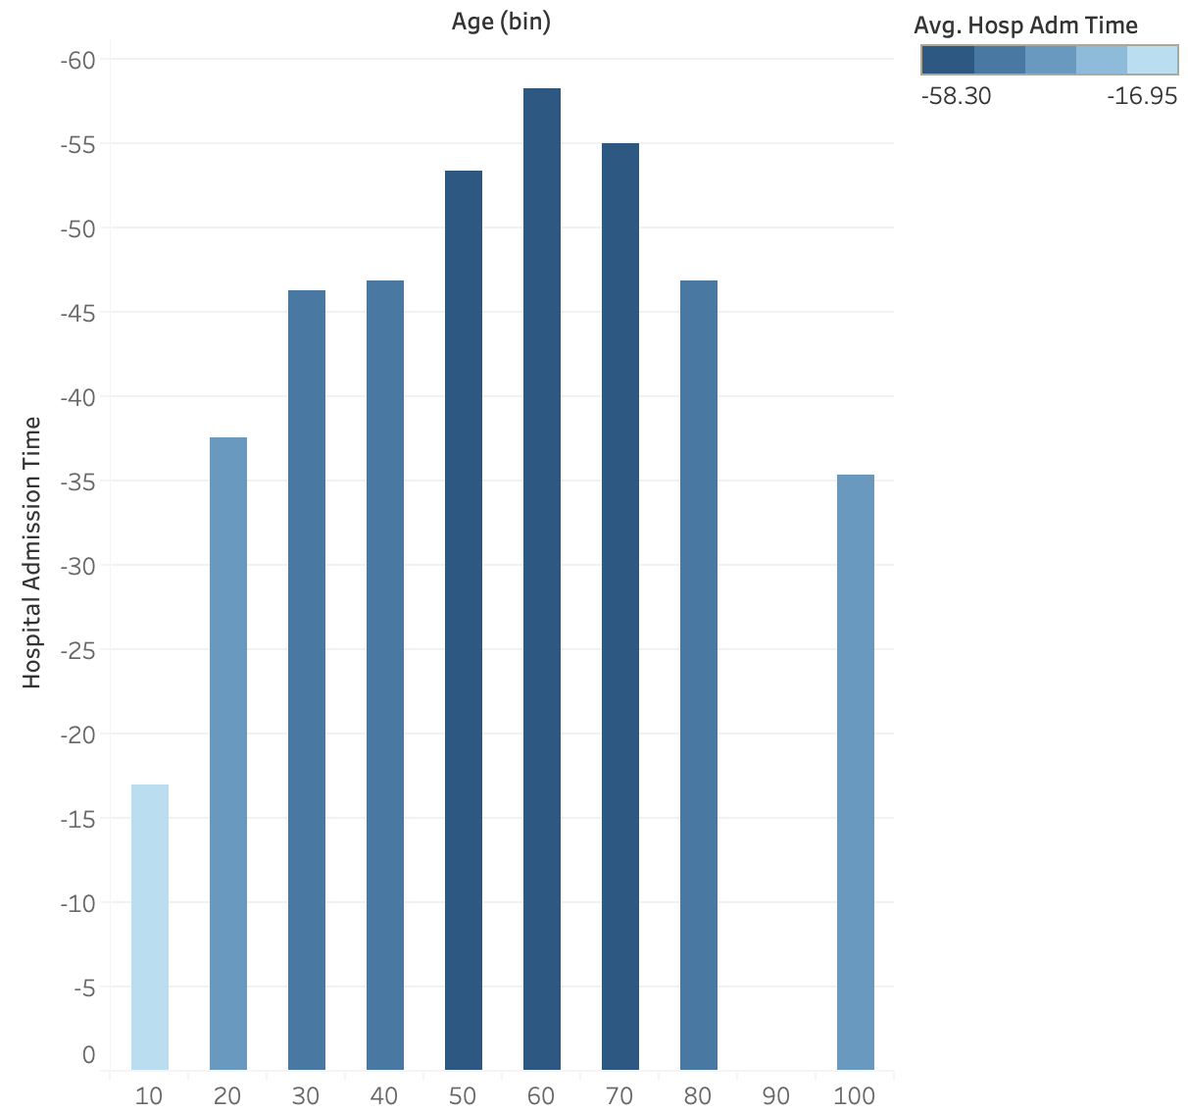
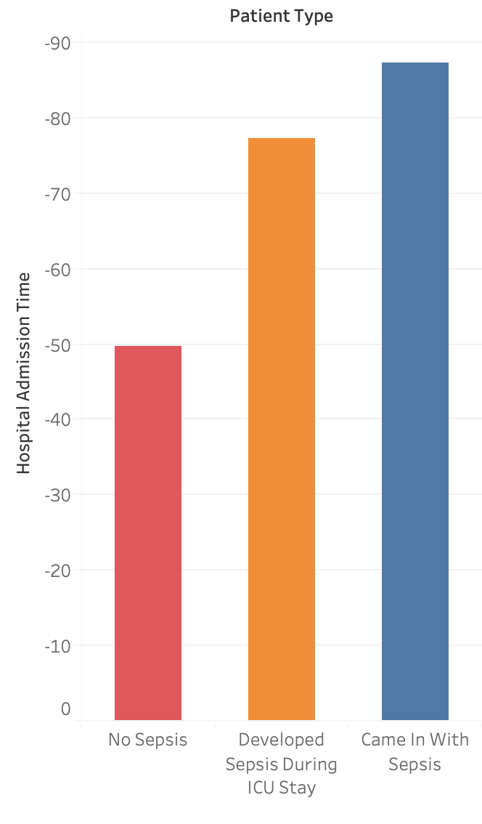
Older patients and Sepsis patients have longer
Hospital Admission Time

Slide 15
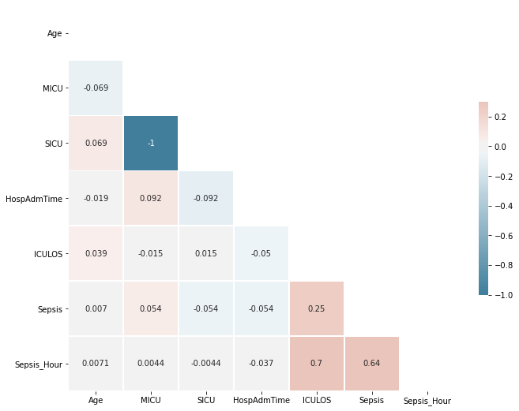
ICULOS and Sepsis Hour strongly correlated

Slide 16
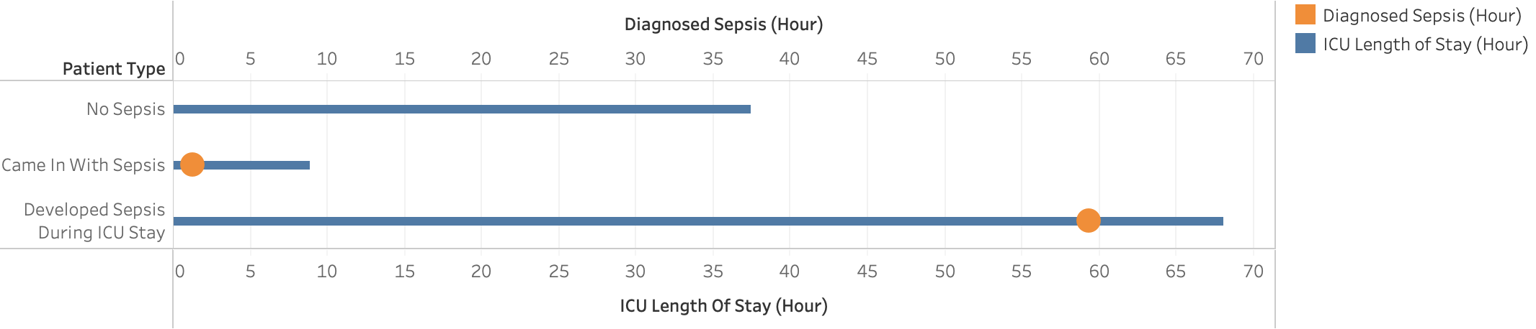
Patients who developed Sepsis likely left ICU (no more records)
within 8 hours after Sepsis diagnosis

Slide 17
Predictive Models

Slide 18
Methodology
Data Cleaning
Model Selection
NAs: > 40% feature columns were dropped.
Fill NA with median values.
Dropped non-meaningful columns.
Accuracy, Recall, Precision and ROC/AUC scores are used. Higher recall is preferred.
01
03
02
04
Files Aggregation
Modeling with un-/aggregated data
40k individual hourly patient medical records.
Unaggregated: per patient per hour.
Aggregated: per patient.
Notes:
let me walk you through the methodology of our predictive models.
First, we looked at the data - we found we have 20k+ individual patient medical records. Within each file, it is an hourly vital records of one patient.
Second, data cleaning. Like vyshak touched upon, We had dozens of columns to begin with, but a lot of the columns have NA values… By observing the distribution % of NA values within the columns,
Higher recall is preferred: recall captures false negative rate - which is predicting as not having sepsis

Slide 19
Selected features list
HR
O2 Saturation
Spontaneous bacterial peritonitis (SBP)
Mean arterial pressure (MAP)
Diastolic Blood Pressure (DBP)
Respirations
Age
Gender
Hospital Admission Time
ICULOS - Intensive Care Unit Length of Stay
Notes:
Vitals + demographics

Slide 20
#1 Non-temporal Approach Unaggregated Data
Ignore the time component and treat record as independently and identically distributed.
This approach would help in predicting Sepsis at each hour for any patient (with or without patient past data).
Notes:
So for the first set of models - we used Non-temporal Approach with Unaggregated Data. The grain of this dataset is one patient at one hour.

Slide 21
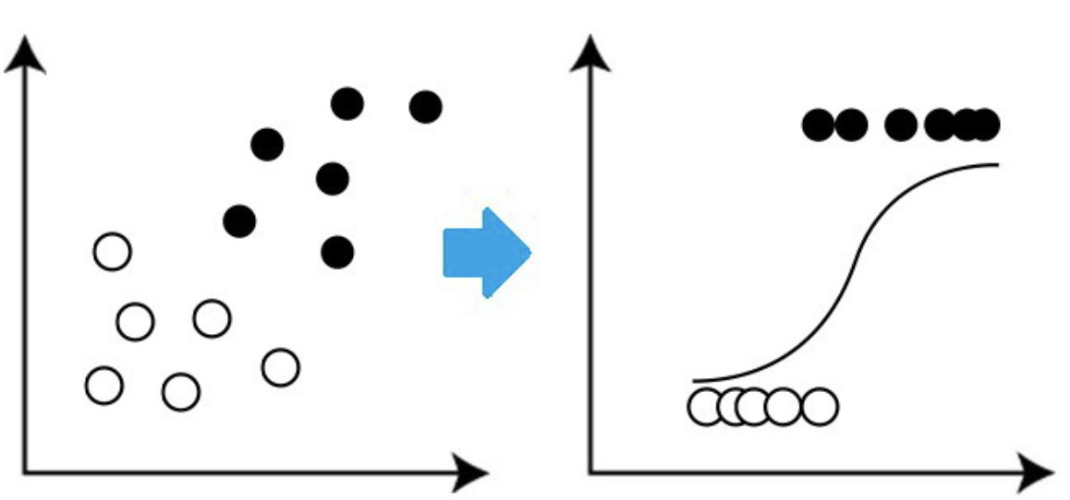
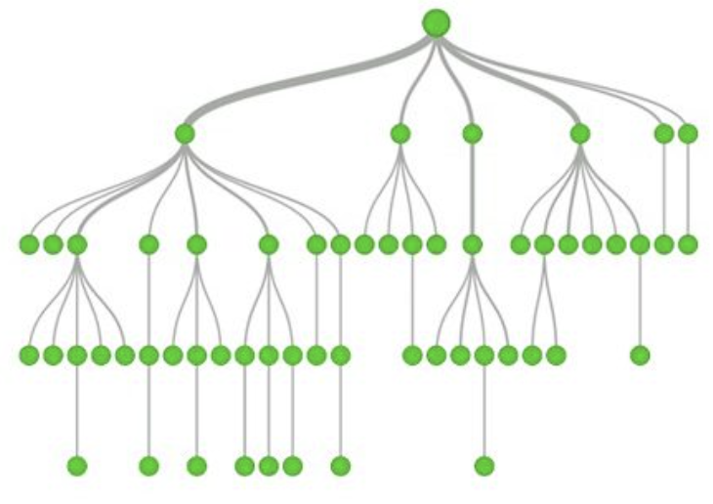
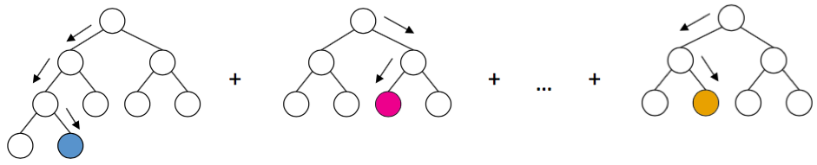
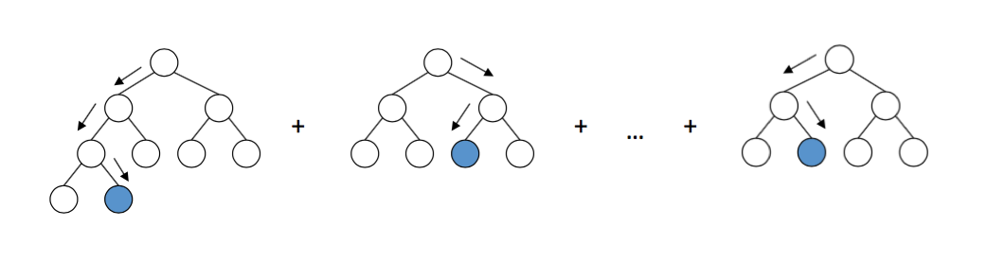
Unaggregated Data - Models used
Very skewed dataset.
Neg. / Pos. = 54
Logistic Regression
Decision Tree
1
4
2
3
XGBoost
Gradient Boost
Notes:
We used 4 different models to predict sepsis for a patient at a certain hour. We used xxxx.
One thing worth mentioning here is that we are dealing very skewed data, 1,066,979/19,568. 50:1 ratio, therefore in the gradient boost model, we made sure that we are sampling from the training set according to this weight, basically adjusting the dataset to a balanced dataset.

Slide 22
Unaggregated Data - Model Performance
ROC: 70%
ROC: 70%
ROC: 80%
ROC: 85%
Logistic Regression
Decision Tree
Gradient Boost
XGBoost
Accuracy: 0.982
Precision: 0.362
Recall: 0.002
Accuracy: 0.976
Precision: 0.362
Recall: 0.4114
Accuracy: 0.912
Precision: 0.093
Recall: 0.445
Accuracy: 0.982
Precision: 0.812
Recall: 0.026

Slide 23

Unaggregated Data - Model Selection
ROC: 70%
ROC: 70%
ROC: 80%
ROC: 85%
Logistic Regression
Decision Tree
Gradient Boost
XGBoost
Accuracy: 0.982
Precision: 0.362
Recall: 0.002
Accuracy: 0.976
Precision: 0.362
Recall: 0.4114
Accuracy: 0.912
Precision: 0.093
Recall: 0.445
Accuracy: 0.982
Precision: 0.812
Recall: 0.026
Notes:
Recall: tp / (tp + fn): fn -> higher risk
Precision: tp / (tp + fp)

Slide 24
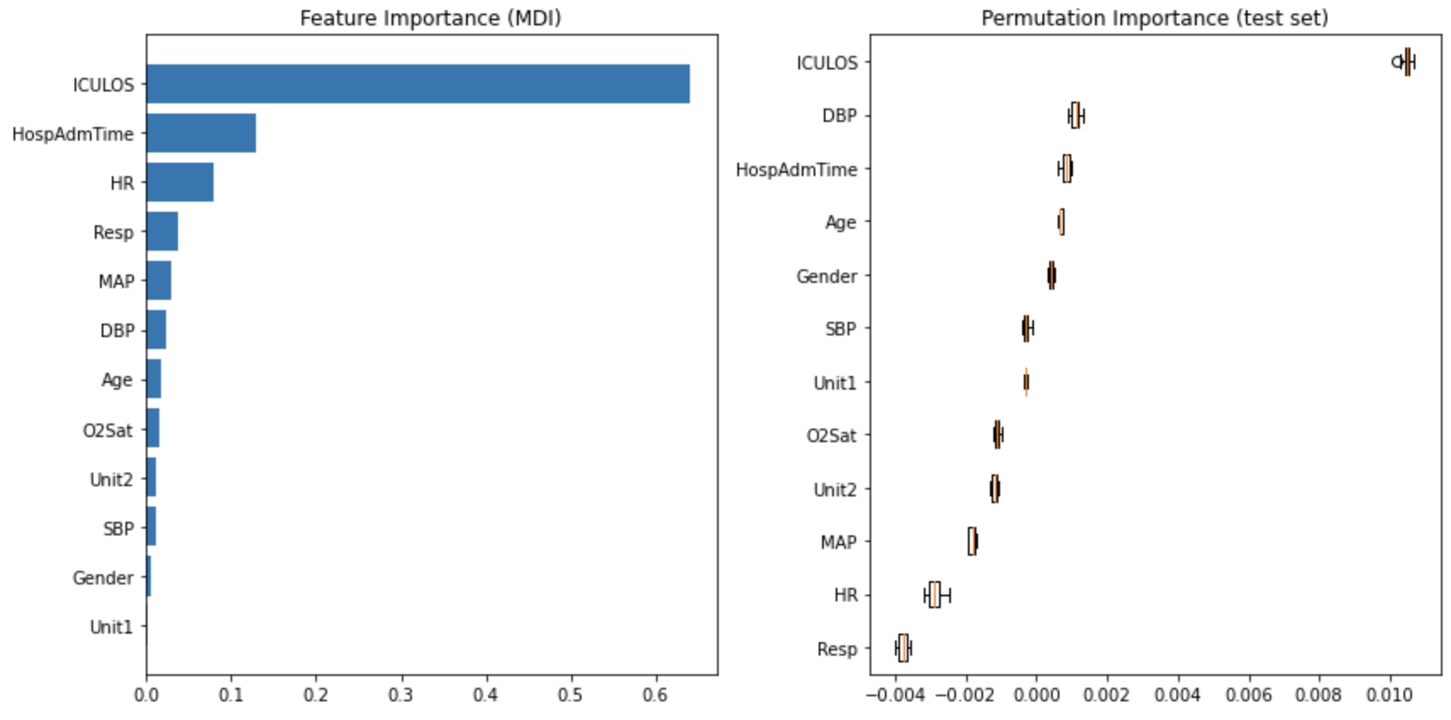
Gradient Boost Feature Importance

Slide 25
#2 Non-temporal Approach Aggregated Data
Aggregate data by patient and feature engineer maximum, minimum and variance of the vitals variables
This approach would help capture the fluctuation in the patients’ condition for
predicting Sepsis.
Notes:
And for the second set of models - we used Non-temporal approach with aggregated data. We aggregate each patient's medical record so each patient will only have one row of record. We feature engineered max, min and variance of patients vitals record, like heart rate, temperature, blood pressure, breaths per minute. This allows us to capture the fluctuation in the patients health condition when predicting the development of sepsis.

Slide 26
Aggregated Data - Models used
Logistic Regression
Decision Tree
1
4
2
3
XGBoost
Gradient Boost
Notes:
Like what we done to unaggregated data, we used the same 4 different models to predict sepsis for a patient. Like Isabel mentioned, the data set is very skewed. Therefore,again we used gradient boost model to help us to balance the data set.

Slide 27
Aggregated Data - Model Performance
ROC: 69%
ROC: 73%
ROC: 90%
ROC: 89%
Logistic Regression
Decision Tree
Gradient Boost
XGBoost
Accuracy: 0.931
Precision: 0.764
Recall: 0.095
Accuracy: 0.921
Precision: 0.466
Recall: 0.504
Accuracy: 0.943
Precision: 0.605
Recall: 0.657
Accuracy: 0.956
Precision: 0.830
Recall: 0.501

Slide 28
Aggregated Data - Model Selection
ROC: 69%
ROC: 73%
ROC: 90%
ROC: 89%
Logistic Regression
Decision Tree
Gradient Boost
XGBoost
Accuracy: 0.931
Precision: 0.764
Recall: 0.095
Accuracy: 0.921
Precision: 0.466
Recall: 0.504
Accuracy: 0.943
Precision: 0.605
Recall: 0.657
Accuracy: 0.956
Precision: 0.830
Recall: 0.501

Slide 29
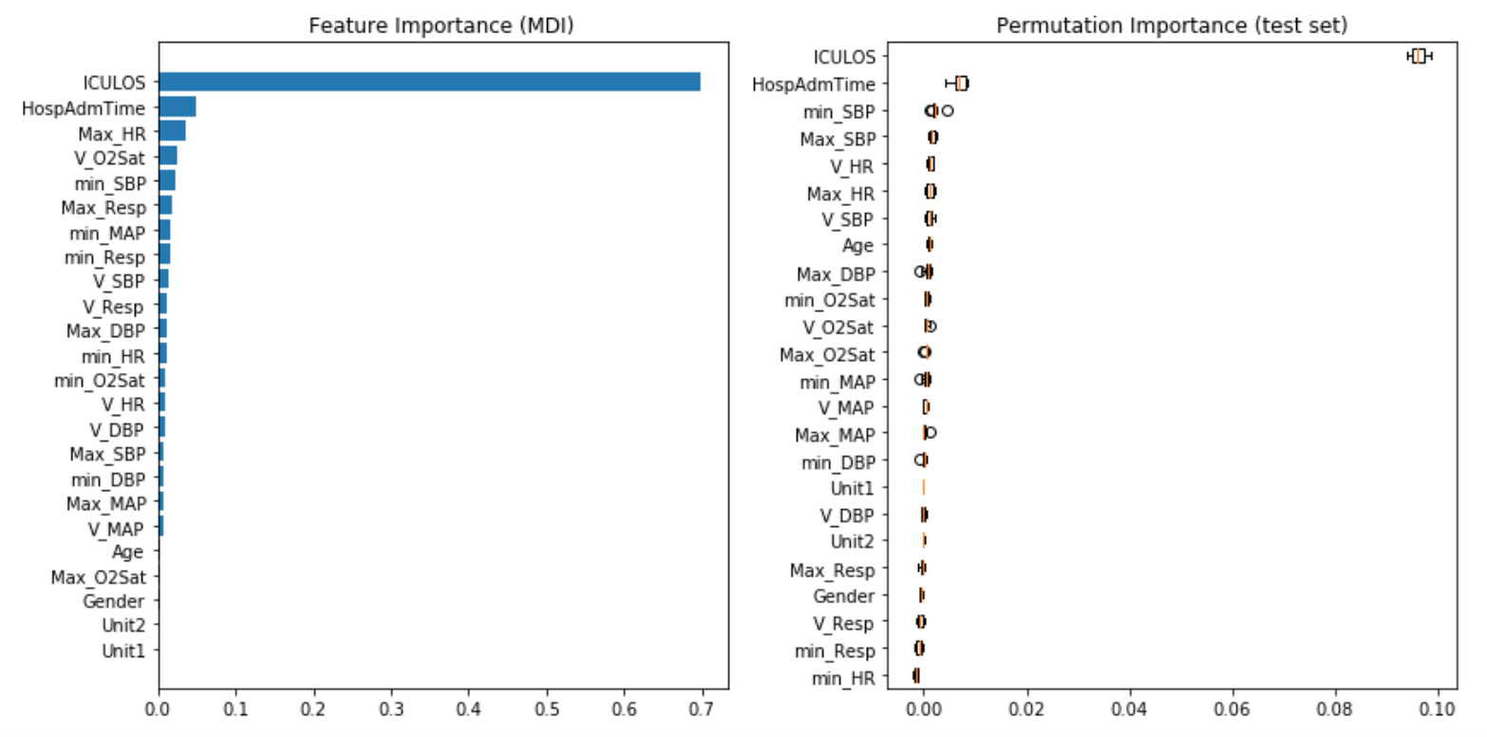
Gradient Boost Feature Importance
Notes:
ICU length of stay
Hours between hospital admit and ICU admit
Heart rate
Systolic BP

Slide 30
Conclusion
When data is limited, we recommend unaggregated data model with gradient boosting / decision tree to predict sepsis
When data is more complete, we recommend aggregating the data and then use gradient boosting to predict sepsis
ICU length of stay and hospital admission time is the most important feature predicting a patient’s sepsis development
Notes:
When data is limited, let's say we just received this patients only have 1 or 2 hours of record
When we have a more complete data of a patients, we can use our gradient boosting model based on our aggregate data.

Slide 31
Next Steps
Get a more complete recording of the vital data to assess its importance in sepsis prediction
Consult with healthcare professionals to consider other factors that can be easily retrieved and included into the model
Suspect two-way causal effects between ICU length of stay/hospital admission time and Sepsis development
Notes:
People who have chronic conditions, such as diabetes, kidney or lung disease, or cancer, People who have weakened immune systems

Slide 32
Thank You!

